Slide 1
The period of time in U.S. history before the Civil War is known as the Antebellum Era (1800-1860)

Slide 2
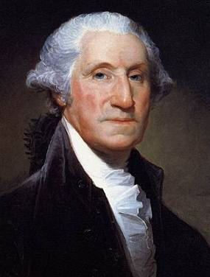
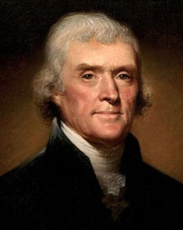
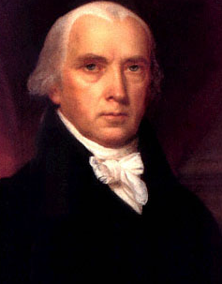
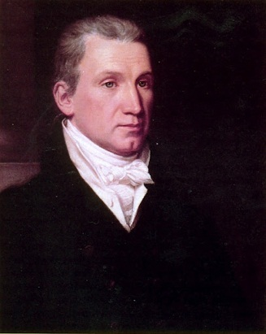
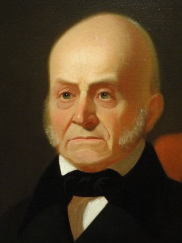
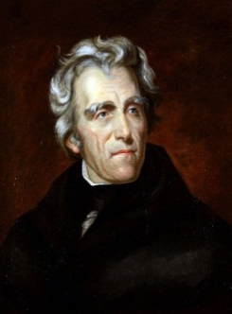
Jefferson’s presidency marked the start of nearly 30 years of dominance by the Democratic-Republicans
8 yrs
George Washington
(1789-1797)
4 yrs
John Adams
(1797-1801)
8 yrs
Thomas Jefferson
(1801-1809)
8 yrs
James
Madison
(1809-1817)
8 yrs
James Monroe
(1817-1825)
4 yrs
John Quincy Adams
(1825-1829)
8 yrs
Andrew Jackson
(1829-1837)
Federalist Party
Democratic-Republican Party
Democratic Party

Slide 3
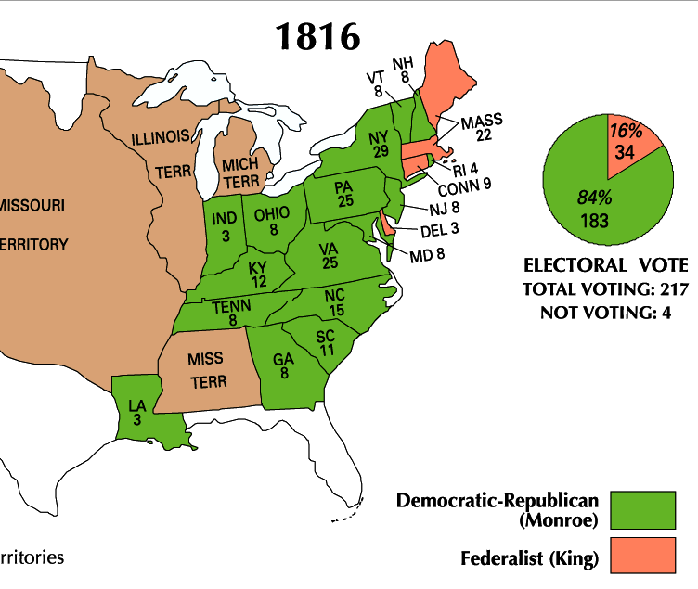
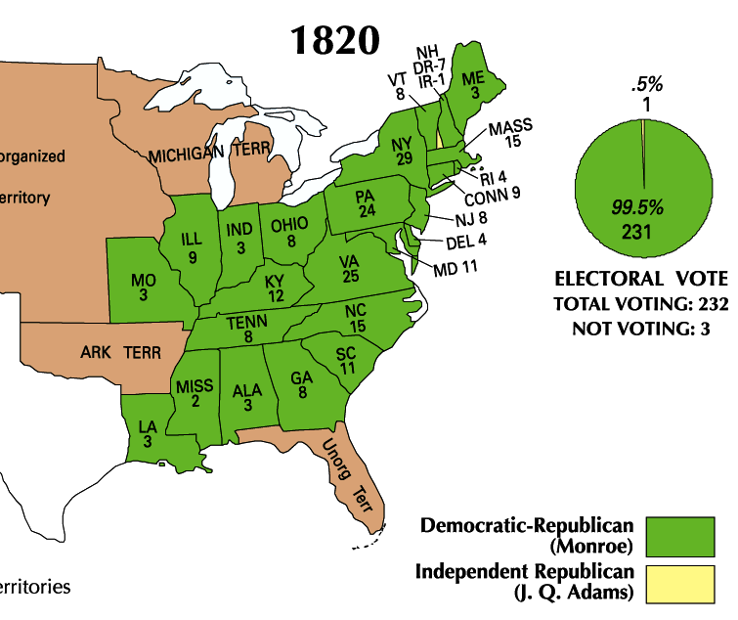
James Monroe was overwhelmingly elected president in 1816 & 1820
Monroe’s presidency began during an era of increased nationalism after the War of 1812 known as the “Era of Good Feelings” (1815-1825)

Slide 4
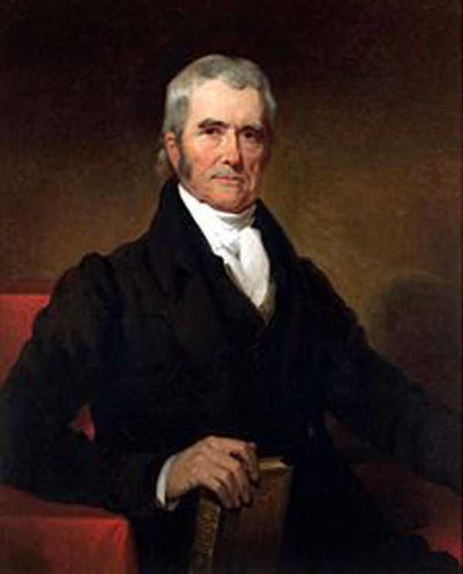
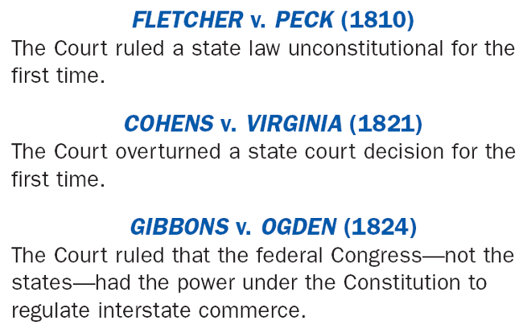
Monroe & the Dem-Republicans in Congress used this time to promote American nationalism & unity in 3 ways:
#1: Government Increase the power of the national gov’t over the states
John Marshall (1801-1835) used the Supreme Court to strengthen the power of the national government
Notes:
4

Slide 5
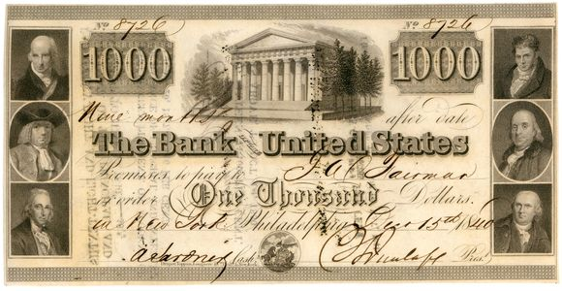
#2 Economy: Encourage industry & transportation to link the South, North, & West
In 1816, Congressman Henry Clay proposed the American System to unify the economies of the North, South, and West & aid American businesses
Create a Second Bank of the United States, 1816
(loose lending contributed to Panic of 1819)
2. Tariff of 1816
A high tariff on imported goods to encourage industry & protect US manufacturers
3. Improve transportation with roads and canals - promote trade & unite country
Notes:
5

Slide 6
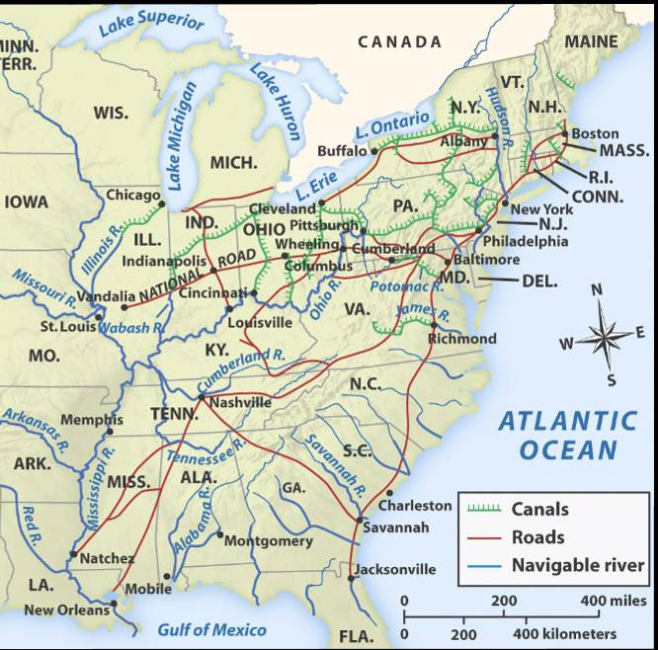
The American System allowed the USA to create a national market economy for the first time
Western farms grew grains
& raised livestock that fed the nation
Northern factories made manufactured goods that were sold throughout the country
Southern cotton was used in northern textiles factories
Notes:
6
We’ll talk about this “market revolution” more in-depth later this unit. This is just a preview in order to understand the importance of Henry Clay’s American System. The emphasis here is on the politics of the era, which should help students understand how the national government promoted a national market economy that, by the 1810s, had emerged as strong regional economies due to new technological innovations (cotton gin, interchangeable parts, Singer sewing machines, Slater mills, McCormick reaper, Deere steel plow, etc.) Again, we’ll discuss these details in the next set of notes.

Slide 7
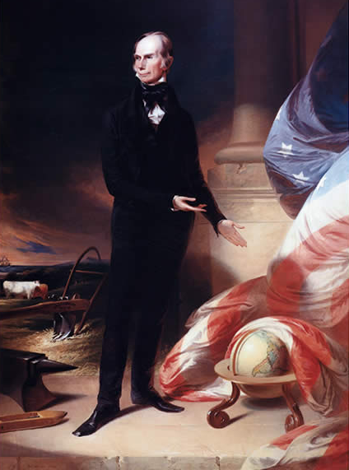
Kentucky Congressman Henry Clay
What aspects of this portrait reveal parts of Henry Clay’s “American System”?

Slide 8
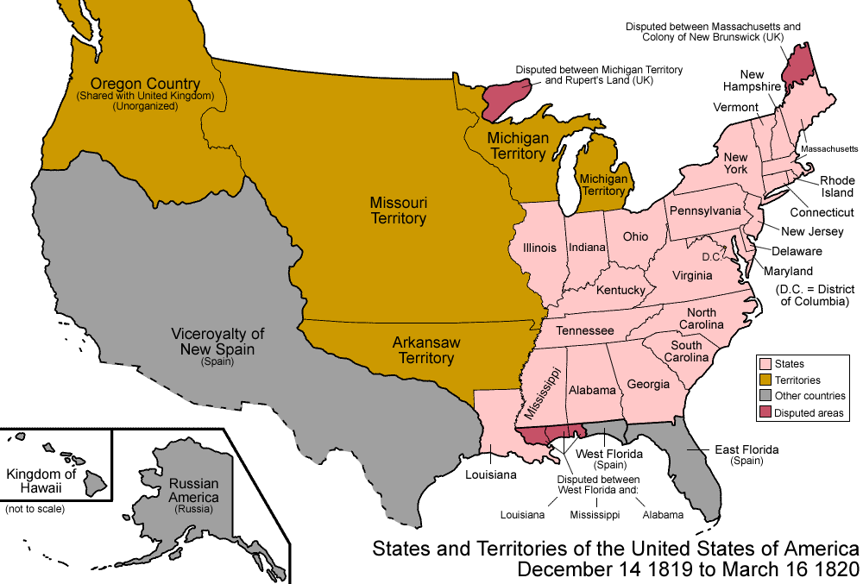
#3: Expansionist Policy Increasing America’s borders & America’s role in world affairs
After the War of 1812, Americans flooded into the West; By 1840 over ¹/₃ of the population lived in the West
Louisiana (1812)
Indiana (1816)
Mississippi (1817)
Illinois (1818)
Congress quickly admitted 5 new states to the Union
Alabama (1819)
Economic & territorial growth created a need to settle America’s national borders
Notes:
8

Slide 9
President Monroe & his Secretary of State John Quincy Adams used expansionist policy to promote nationalism & territorial expansion
In 1818, the USA and Britain agreed to establish the Canadian border at the 49°
In 1819 the USA gained Florida from Spain with the Adams-Onis Treaty
Notes:
Adams-Onis Treaty: Spain officially gave up all claims to OR territory at northern border of CA (42nd Parallel)
US paid $5 million in damages for uprisings
Spain got official recognition as sovereign of TX, retained territory in the west

Slide 10
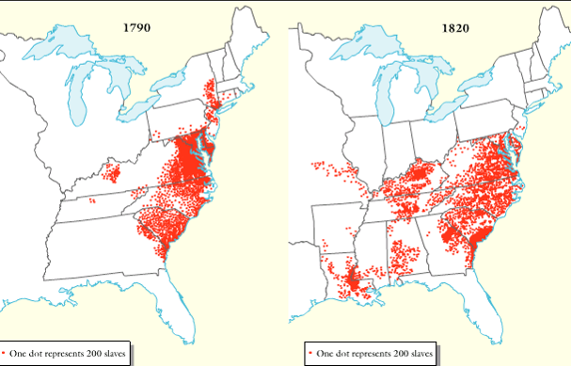
The Era of Good Feelings was a time of nationalism, but there were growing problems between the North & South (sectionalism)
American Slave Population, 1790-1820
Northerners & Southerners disagreed over slavery, taxes, & the role of government
These disagreements dominated politics from 1820 - 1860

Slide 11
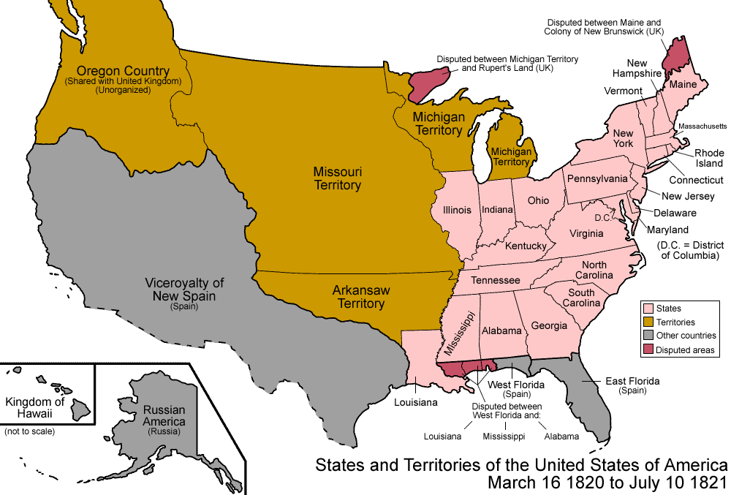
When Missouri applied to become a U.S. state, sectionalism emerged
Northerners did not want Southern states to increase power in the national gov’t
If Missouri entered as a slave state, the South would have 2 more Senators than the North
Notes:
Because of the 3/5 Compromise, the South had more members of the House of Representatives; President Monroe was from Virginia, so the South controlled the presidency too
11

Slide 12
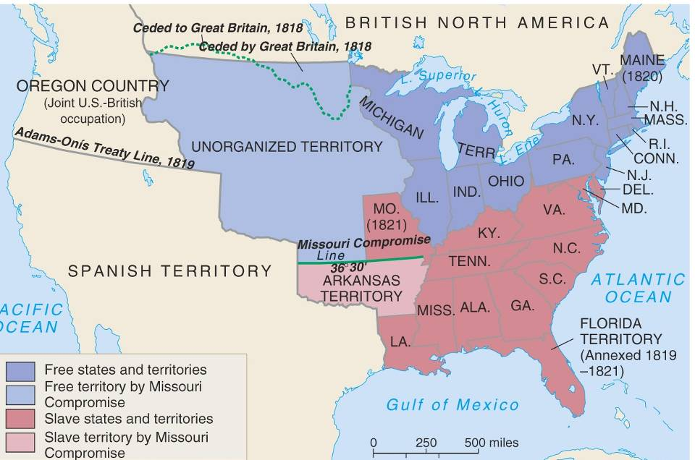
In 1820, Henry Clay negotiated the Missouri Compromise (Compromise of 1820)
Maine broke from Massachusetts and became a free state
Missouri became a slave state
Slavery was outlawed in all western territories above the latitude of 36°30'
Notes:
12

Slide 13
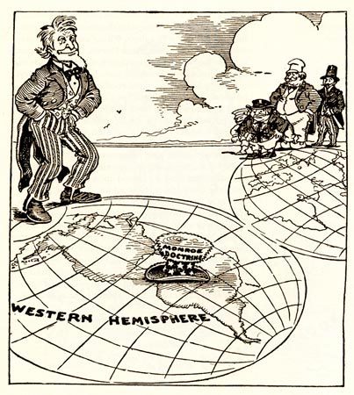
1823: the Monroe Doctrine asserted US independence from Europe. Warned European nations that the USA would protect the Western Hemisphere & that the U.S. would not interfere in Europe.

