Slide 1
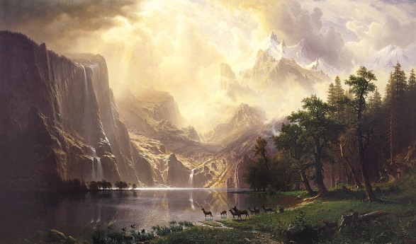
Art of the American West

Slide 2
Albert Bierstadt
“The Rocky Mountains, Lander’s Peak”
1863, o/c, 72.5x120.75”, Metropolitan Museum of Art, New York City
Wyoming Range of the Rocky Mountains

Slide 3
“A Storm in the Rocky Mountains, Mt. Rosalie” 1866, o/c, Brooklyn Museum, 83x142”
Based on sketches from 1863 expedition. Named after his mistress (future wife).

Slide 4
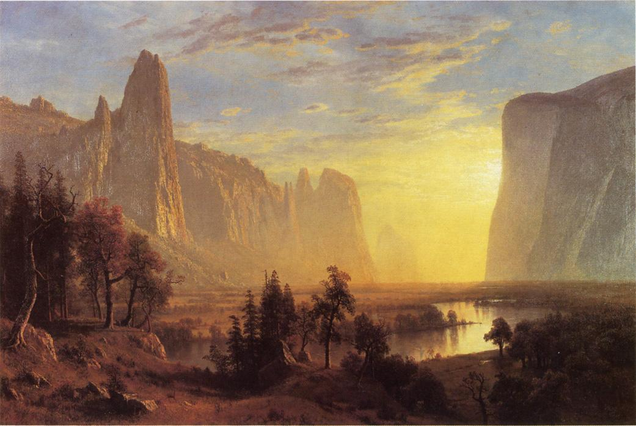
“Yosemite Valley, Yellowstone” 1868, o/c, Oakland Museum of Art, 36x54”

Slide 5
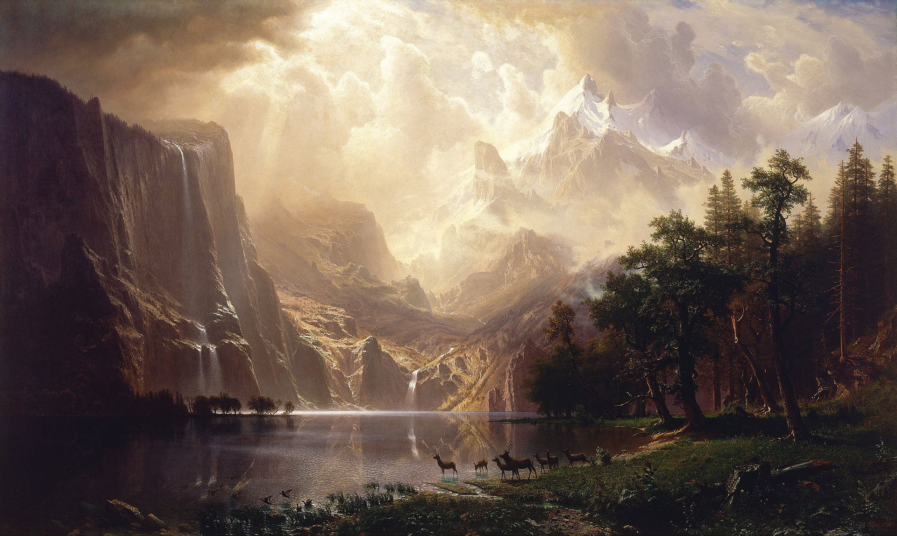
“Among the Sierra Nevada Mountains, California” 1868, o/c, Smithsonian American Art Museum, Washington DC, 72x120”

Slide 6
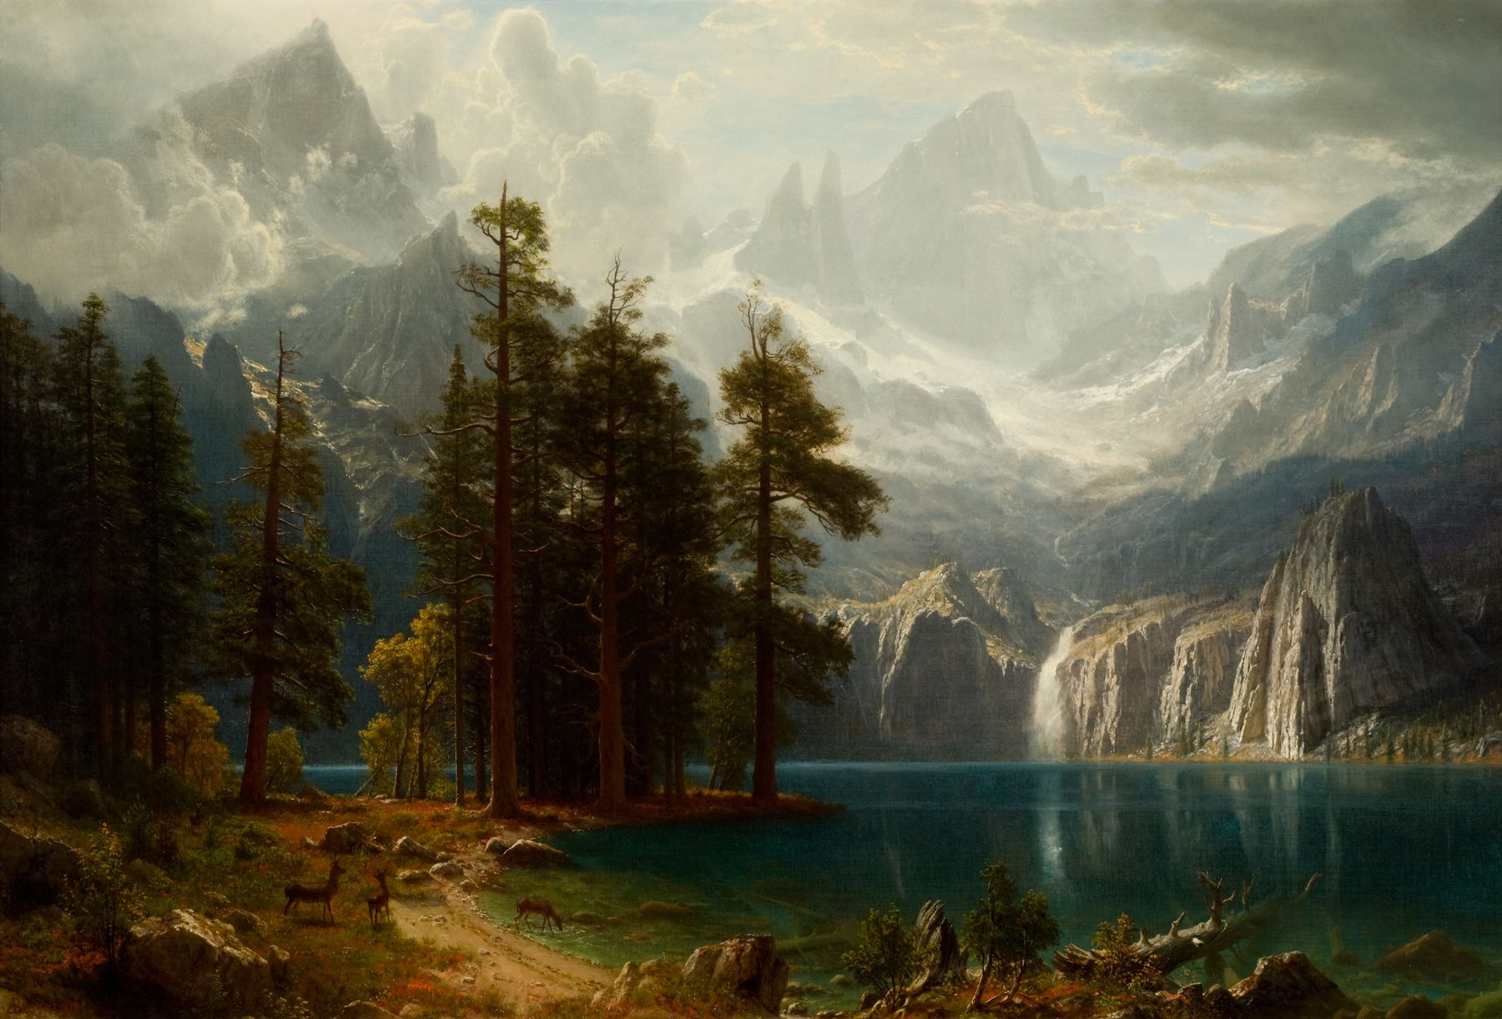
“Sierra Nevada” 1871-1873, o/c, Reynolds House Museum of American Art, Winston-Salem, 38.5x56.5”

Slide 7
“The Last of the Buffalo” 1888, o/c, Buffalo Bill Center of the West, Cody, Wyoming, 60x96.5”
Bierstadt made numerous versions of this painting.

Slide 8
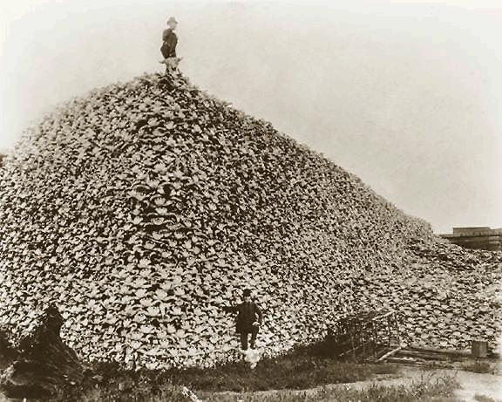

Slide 9
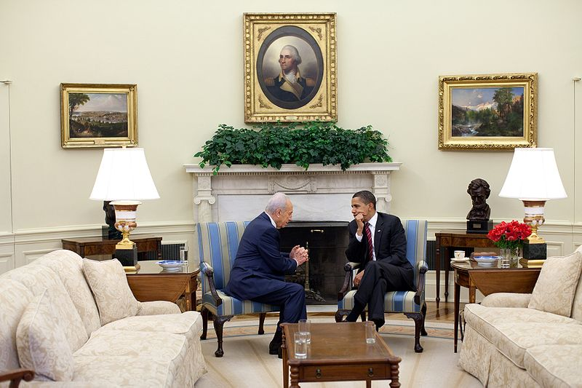
Thomas Moran

Slide 10
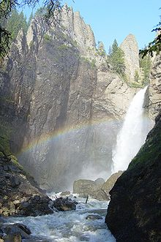
“Tower Falls” 1872, o/c, Gilcrease Museum, Tulsa, Oklahoma

Slide 11
“Hot Springs of Gardiner's River” 1872, watercolor, Private Collection

Slide 12
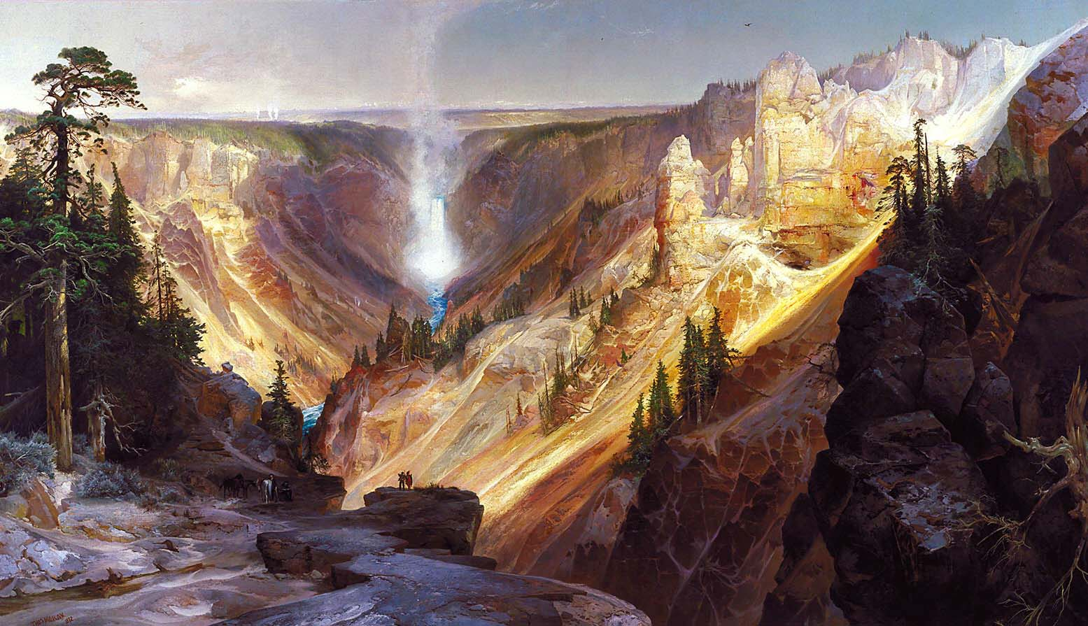
“Grand Canyon of the Yellowstone” 1872, o/c, Department of the Interior Museum, Washington D.C., 7x12’
The 1st of his paintings purchased by Congress– hung in the Senate lobby.

Slide 13
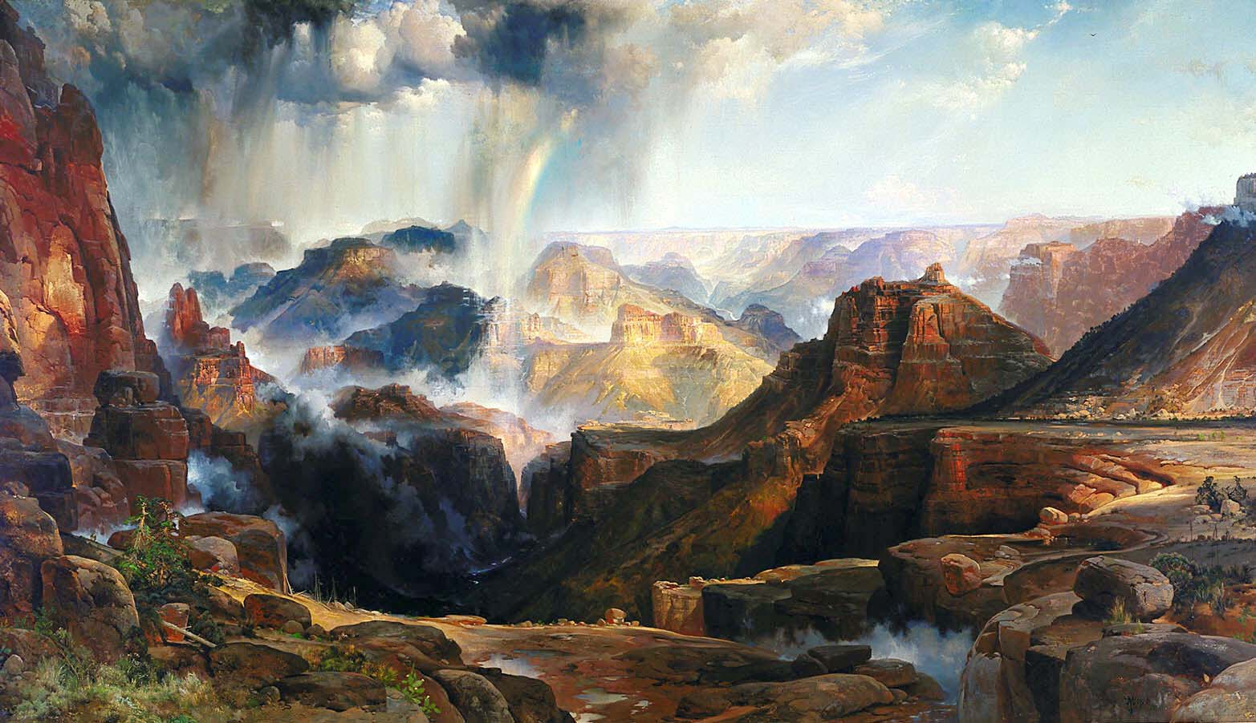
“Chasm of the Colorado” 1873-1874, o/c, Department of Interior Museum, Washington D.C., 7x12’
The 2nd of his paintings purchased by Congress for $10,000 – hung in the Senate lobby.

Slide 14
“Shoshone Falls, Snake River, Idaho” c. 1875, watercolor, Chrysler Museum of Art, Norfolk, VA, 10x14”

Slide 16
Frederic Remington “A Dash for the Timber” 1889, o/c, Amon Carter Museum, Fort Worth, Texas
Painted when he was 28. Commissioned by a wealthy New York industrialist who wanted a painting that “portrayed a life-threatening situation”.

Slide 17
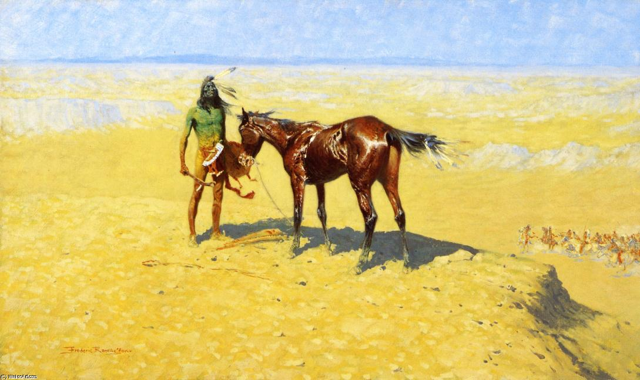
“Ridden Down” 1905-1906, o/c, Amon Carter Museum, Fort Worth, TX

Slide 18
“The Fall of the Cowboy” 1895, o/c, Amon Carter Museum, Fort Worth, Texas
Remington viewed the cowboy as the last figure of American frontier history: hardy, self-reliant, and tragically doomed to extinction in the wake of American progress.

Slide 19
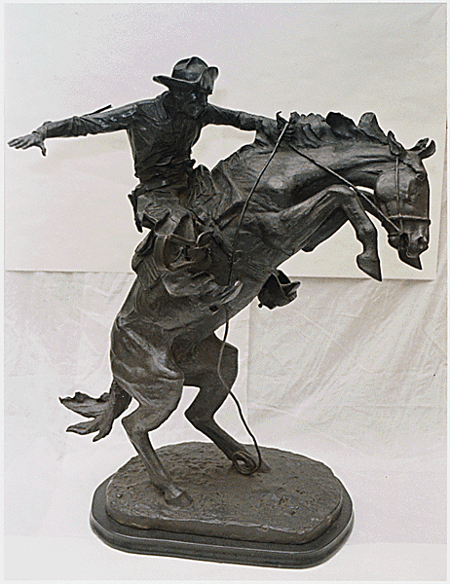
“The Bronco Buster” 1895, bronze sculpture, # 17, 31-1/8" x 13" x 17-1/2"

Slide 20
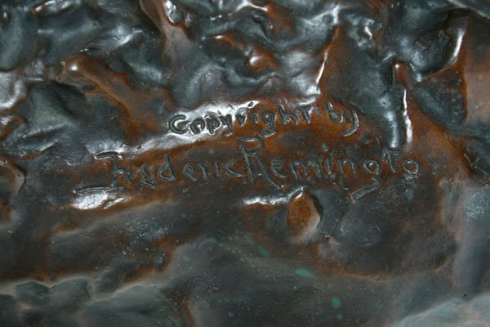
“The Mountain Man” 1903, bronze, 27 3/4 x 12 x 10 in., 51lb., Metropolitan Museum of Art, New York City

Slide 21
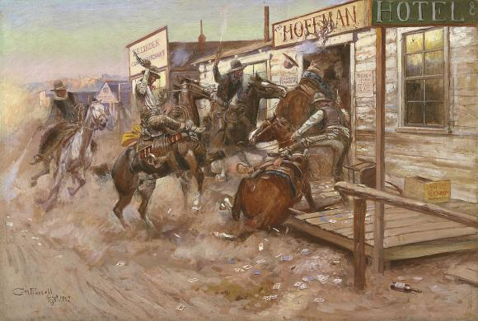
Charles M. Russell
“In Without Knocking” 1909, o/c, Amon Carter Museum, Fort Worth, TX,

Slide 22
“The Buffalo Hunt, No. 39” 1919, o/c, Amon Carter Museum, Fort Worth, Texas
Russell moved to Montana at 16 years old. He was a "real" cowboy, lived with a mountain man and was an adopted brother of the Blackfoot tribe.

Slide 23
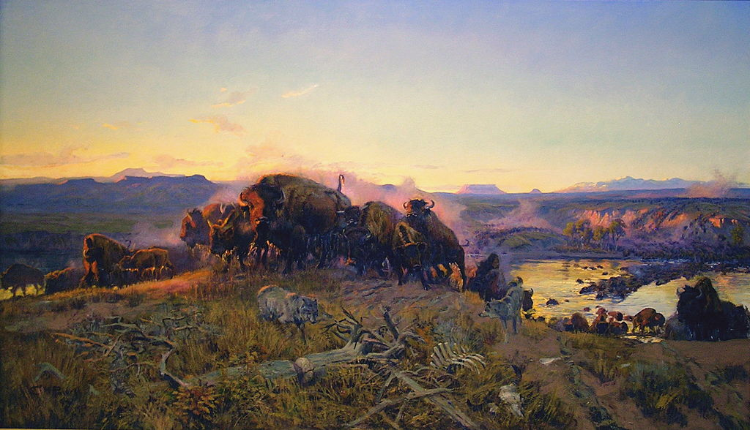
“When the Land Belonged to God” 1914, o/c, Montana Historical Society, Helena, MT, 72x42.5”

Slide 24
“Laughter Kills Lonesome” 1925, o/c, Montana Historical Society, Helena, MT

