Slide 1
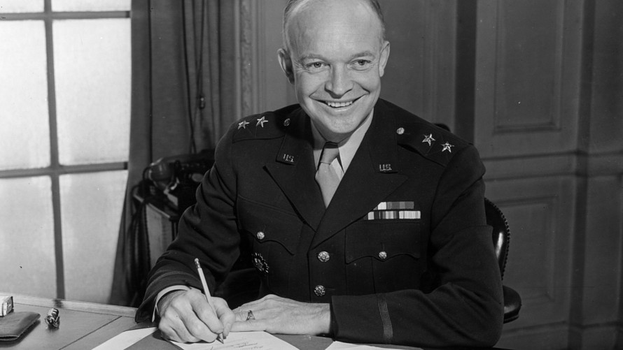
EISENHOWER (1953-1961)
& THE COLD WAR
Notes:
1

Slide 2
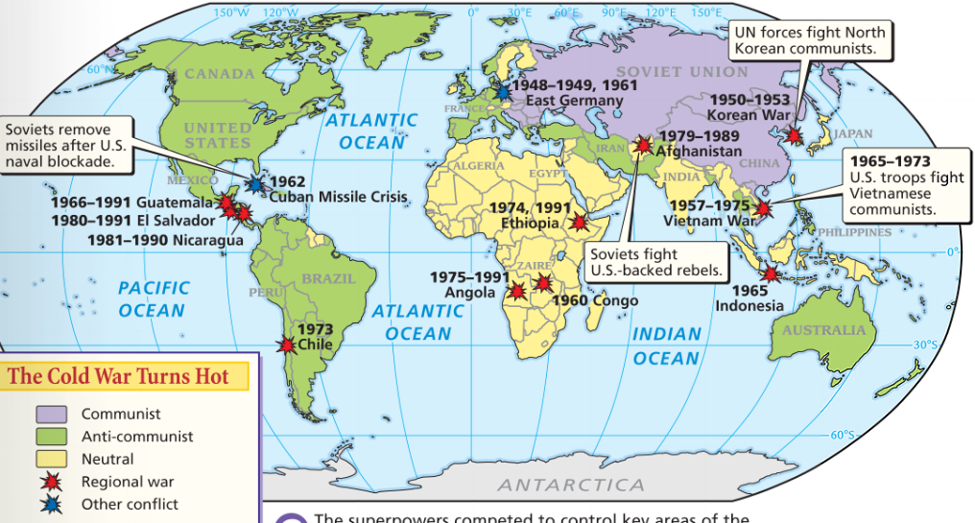
During the Cold War, the USA & USSR were rival superpowers who competed to spread their ideology
Notes:
2

Slide 3
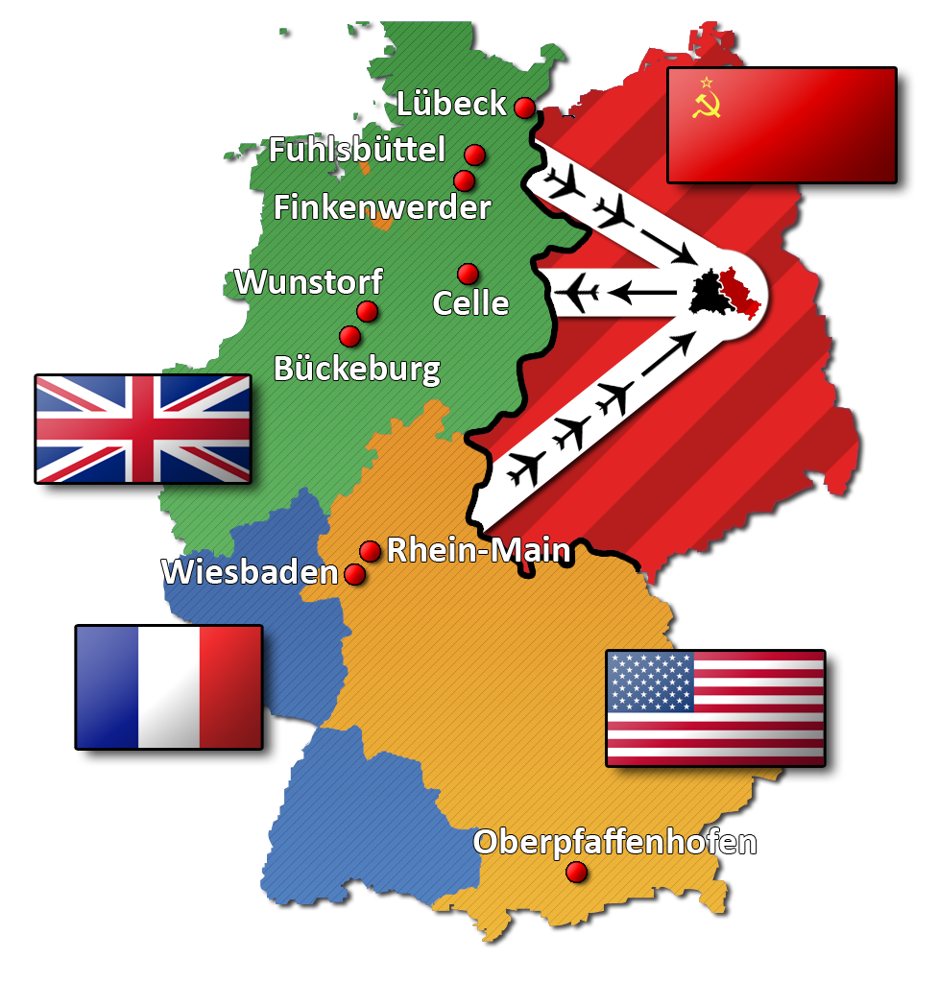
From 1945 to 1949, President Truman used containment to successfully stop the spread of communism in Europe
Marshall Plan
Truman Doctrine
NATO
Berlin Airlift
Notes:
3

Slide 4
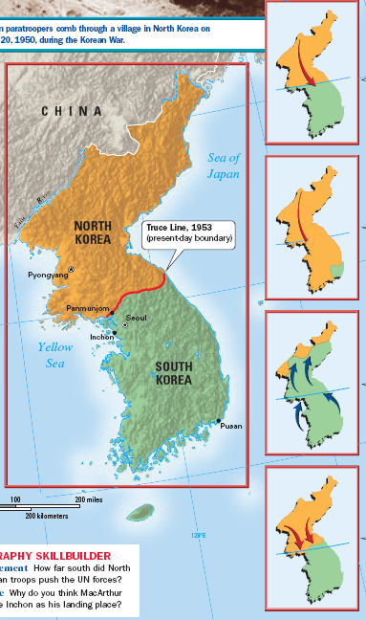
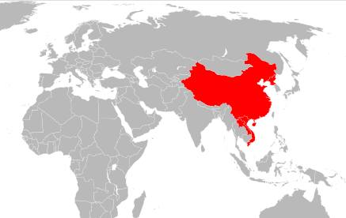
When communism spread to China in 1949, the USA feared the “domino theory” and became more aggressive in its efforts to stop communism (Korean War)

Slide 5
From 1949 to 1960, the Cold War escalated as a result of a nuclear arms race, space race, & espionage
Notes:
5

Slide 6
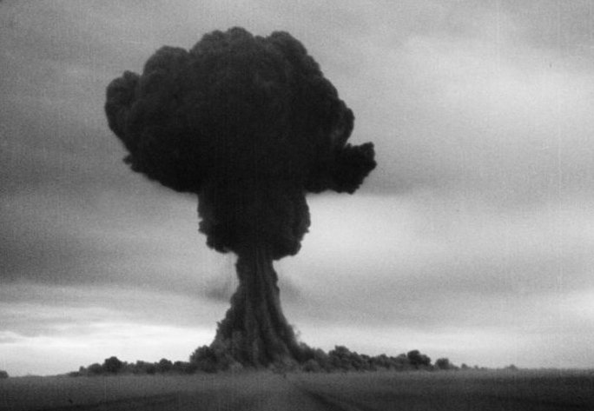
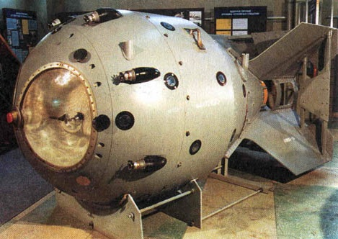
The U.S. monopoly on nuclear weapons ended in 1949 when the USSR successfully tested an atomic bomb
The Soviet development of the atomic bomb led to a nuclear arms race between the USA & USSR
Notes:
6

Slide 7
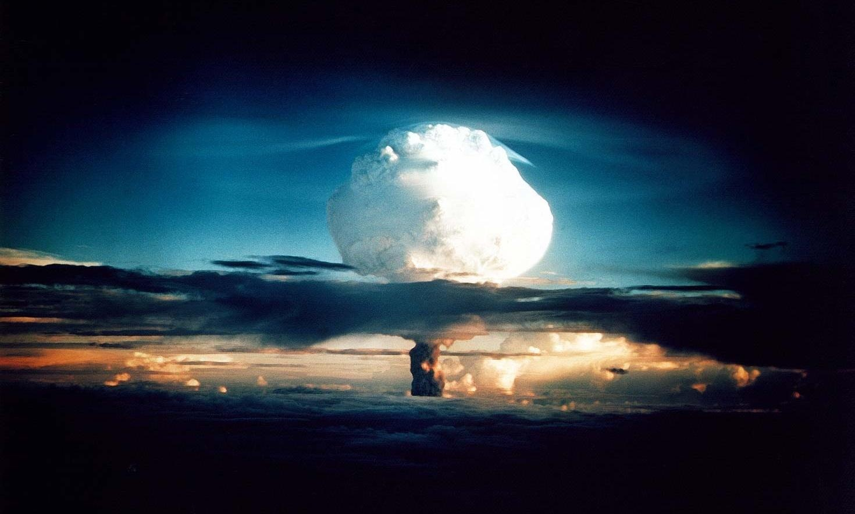
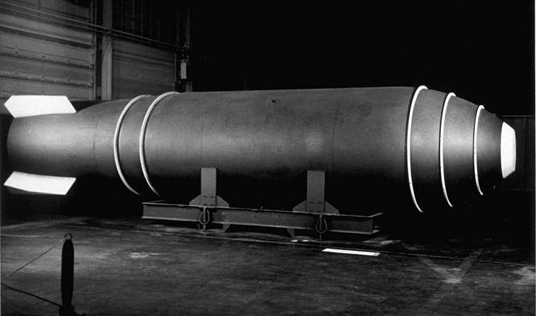
In 1952, the USA tested the first hydrogen bomb which is 1,000 times more powerful than the atomic bomb
The Soviet Union responded by detonating its own hydrogen bomb in 1953
Notes:
7

Slide 8
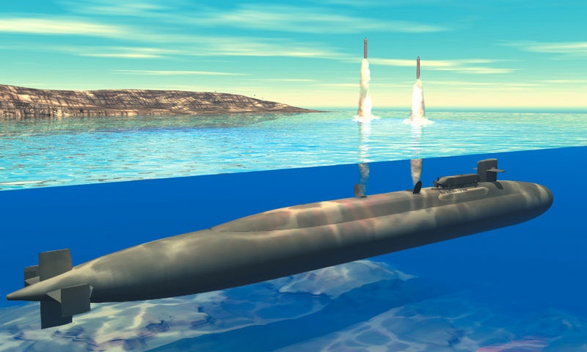
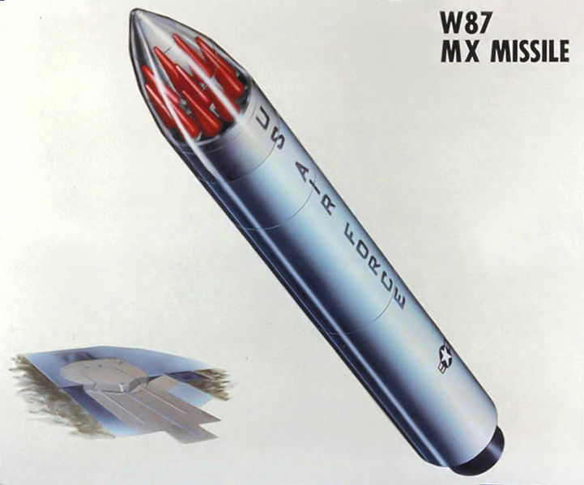
By 1959, both the USA & USSR developed rockets called intercontinental ballistic missiles (ICBMs) that could deliver nuclear warheads to distant targets
U.S. Polaris Submarine
Soviet Transporter Erector Launcher (TEL)
U.S. Titan ICMB from the 1960s
Soviet ICMBs from 1960-1975

Slide 9
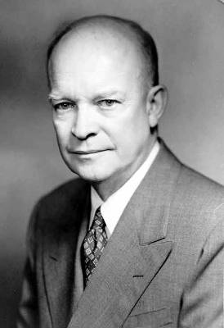
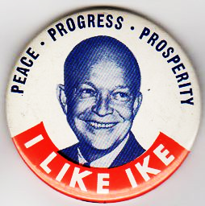
Dwight Eisenhower was elected president in 1952 & served until 1961
Eisenhower was a war hero who planned the D-Day invasion during World War II
His military experience gave Americans confidence that he could face the threat of the USSR during the Cold War
Ike campaign commercial

Slide 10
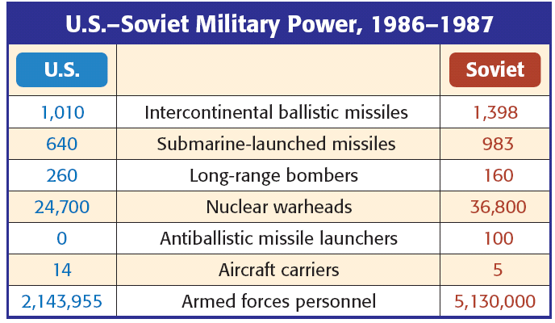
In the 1950s, President Eisenhower escalated the Cold War by using brinkmanship: threatening to use nuclear weapons & willingness to go to the brink of war
If the USSR attacked a NATO member, the U.S. would use massive retaliation: attack every major Soviet city & military target
As a result, the USA & USSR began stockpiling nuclear weapons & building up their militaries
Notes:
10

Slide 11
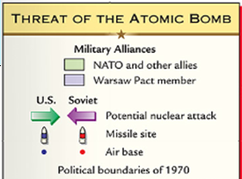
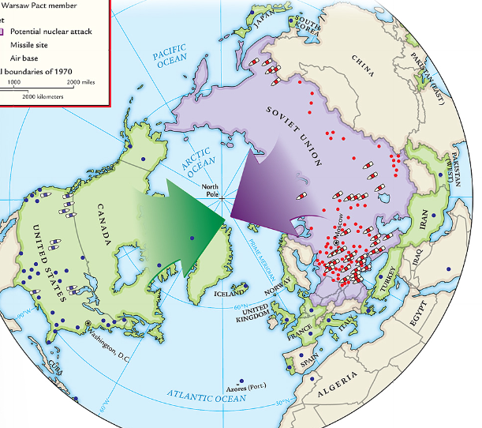
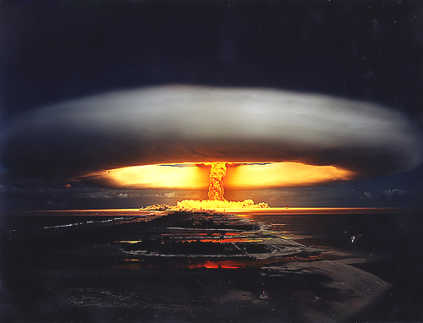
With the USA & USSR in possession of large nuclear stockpiles, each side could destroy each other: this was known as Mutually Assured Destruction (MAD)
Throughout the Cold War, the USA & USSR looked for ways to gain first strike capability
Notes:
11

Slide 12
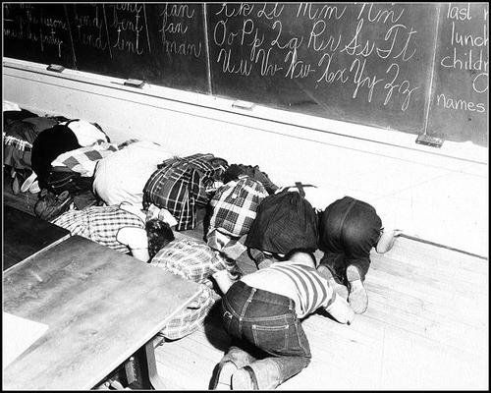
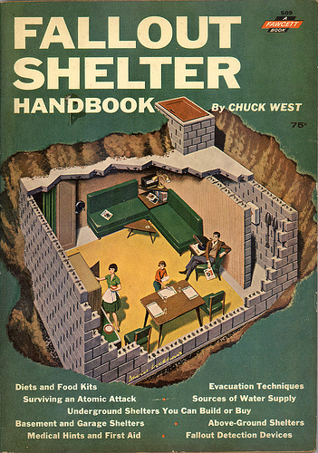
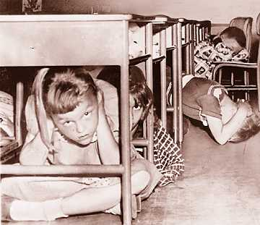
To combat American fears of a nuclear attack, the U.S. government responded in a number of ways:
National and local governments prepared citizens for a Soviet nuclear attack on the United States
Citizens built fallout shelters in their backyards
Cities and schools practiced building evacuations and “duck & cover” drills
Notes:
12

Slide 13
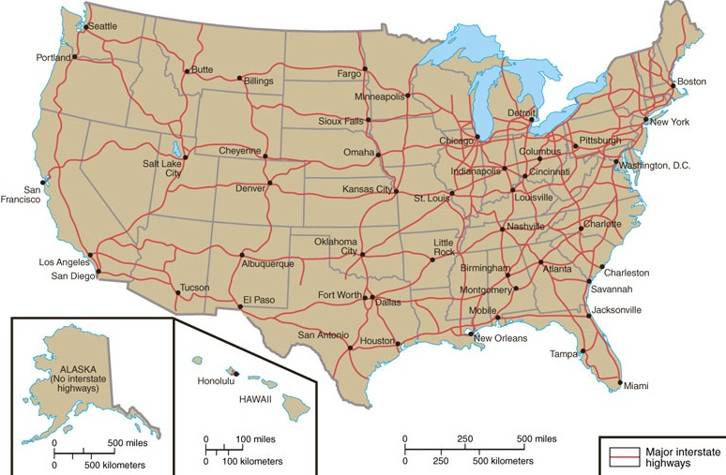
In response to the threat of a Soviet nuclear attack, Congress created the Interstate Highway System in 1956
41,000 miles of highway connected U.S. cities and promoted trade & travel
Highways served as a means to evacuate cities during a potential nuclear attack

Slide 14
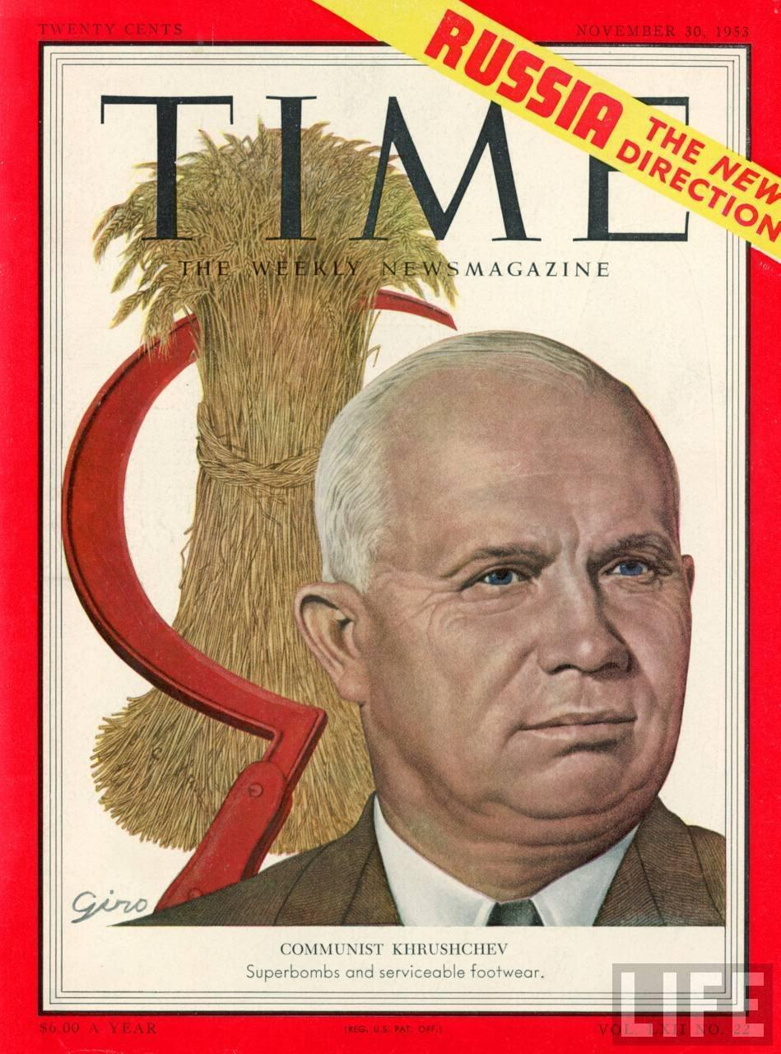
U.S.-Soviet relations changed in 1953 when Stalin died after 30 years of absolute rule over the Soviet Union
Nikita Khrushchev took over and began to aggressively challenge U.S. influence in the world
In 1955, Khrushchev formed a communist alliance to rival NATO, called the Warsaw Pact
In 1956, the Soviet Union threatened expansion into the Middle East
President Eisenhower responded with the Eisenhower Doctrine, pledging the USA to protect the Middle East from Communism

Slide 15
Quick Class Discussion:
Which part of the world did the U.S. promise to protect in the (a) Monroe Doctrine, (b) Roosevelt Corollary, (c) Truman Doctrine, and (d) Eisenhower Doctrine?

Slide 16
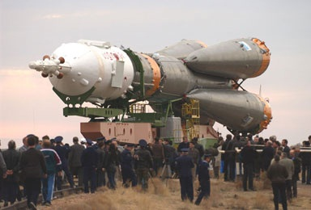
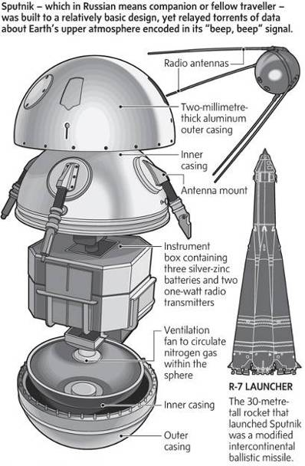
In 1957, the USSR used its first ICBM to launch Sputnik, the first satellite into space
Sputnik shocked Americans who feared the U.S. had fallen behind the USSR in science & technology
As a result of Sputnik, the Cold War escalated into a space race to show American & Soviet dominance
Notes:
16

Slide 17
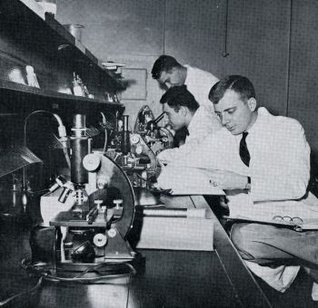
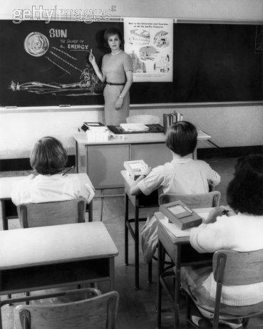
The U.S. government reacted to Sputnik by passing the National Defense Education Act to promote math, science, and technology education and to fund university research

Slide 18
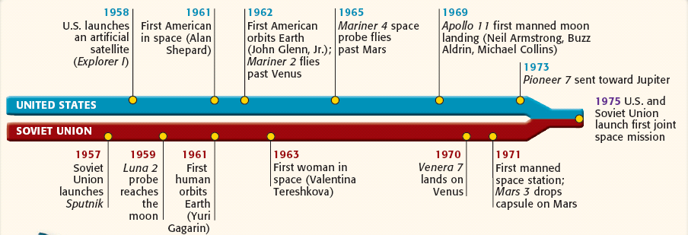
In 1958, the USA created National Aeronautics & Space Administration (NASA) to catch up to the USSR
The USSR repeatedly beat the USA in the space race by launching the first man into orbit & orbiting the moon
Notes:
18

Slide 19
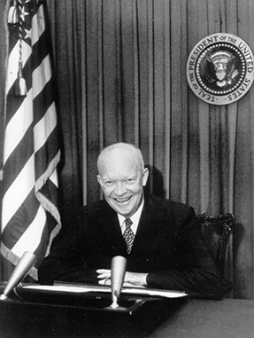
1960 - Eisenhower’s presidency was coming to an end & the Cold War was as tense as ever
Eisenhower’s effectively limited communist expansion during his 8 years as president
…but…
Eisenhower’s build-up of nuclear weapons & use of brinkmanship created the potential for nuclear annihilation
In his farewell speech, Eisenhower warned against the “military industrial complex”—overspending & over-prioritizing military over basic American needs
Americans seemed to be losing the tech. race against the USSR

Slide 20
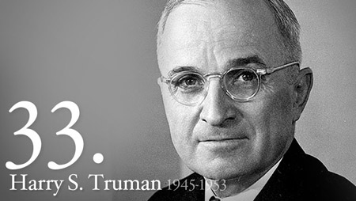
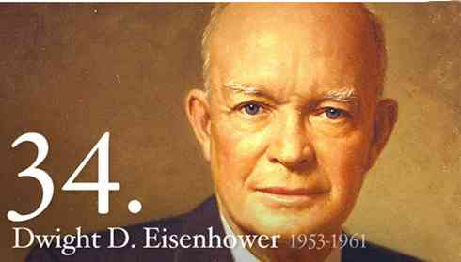
From 1945 - 1960, the USA experienced successes & failures in the Cold War with the USSR
Truman successfully contained communism in Western Europe…
Eisenhower used the CIA & brinkmanship to limit Soviet global influence…
…but saw communism spread in Asia & the USSR match America’s nuclear weaponry
…but the USSR was winning the space race & Americans were anxious about a nuclear war

