Slide 1
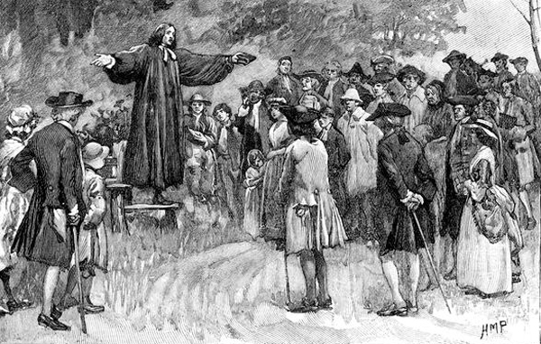
INFLUENCE OF THE PROTESTANT REFORMATION ON 17TH CENTURY COLONIAL AMERICA

Slide 2
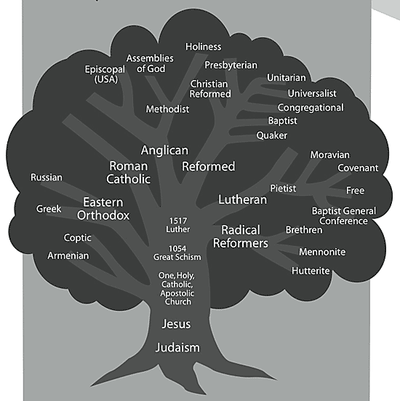

Slide 3
Why was the Protestant Reformation ultimately important to the creation of America?
Calvinism drove the will of the Puritans to establish a religiously pure colony in America
Most of early America was Protestant (except certain Catholic pockets)
Protestantism became one of the defining characteristics of American culture:
Protestant work ethic, democratically structured churches, religious toleration among different religious groups.
(except some Puritans and officials affiliated with the Anglican Church)

Slide 4
How were the Puritan immigrants important to the growth of democracy in the New World?
Congregational church in Massachusetts Bay Colony: Townhall meetings, church members could vote
Simple manhood suffrage in Rhode Island
Fundamental Orders in Connecticut River Colony: Describes government of the colony, has the features of a written constitution, and is considered by some as the first written Constitution in the West, earned Connecticut the nickname The Constitution State.

Slide 5
Differences among the three colonial regions.
New England: Massachusetts, Connecticut, Rhode Island, New Hampshire
Puritan dominated in many areas, less religiously tolerant, more restrictions on civic participation, more industry, less available farm land
Middle Colonies: New York, New Jersey, Pennsylvania, Delaware
Ethnically diverse, religiously tolerant, democratic, Quakers contributed to human freedom, farming, lumbering, ship building, shipping, trade, fur trapping
Southern Colonies: Maryland, Virginia, North Carolina, South Carolina, Georgia
Plantation economy, aristocratic, slavery, cash crops, scattered population, expansionary, some religious toleration (Church of England dominant)

Slide 6
Similarities among all 13 colonies
mostly English
possessed British freedoms
self-government (though not all democratic)
religious toleration (to at least some degree in each colony)
educational opportunity (most in New England; least in the South)
economic opportunity and social self-development
increasingly unique from the British monarchy in character.

Slide 7
