Slide 1
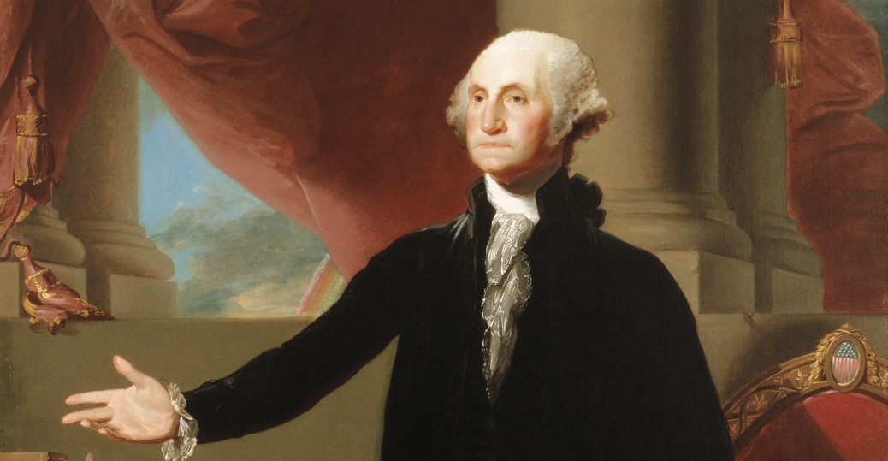
The Glory of America
Early American Art

Slide 2
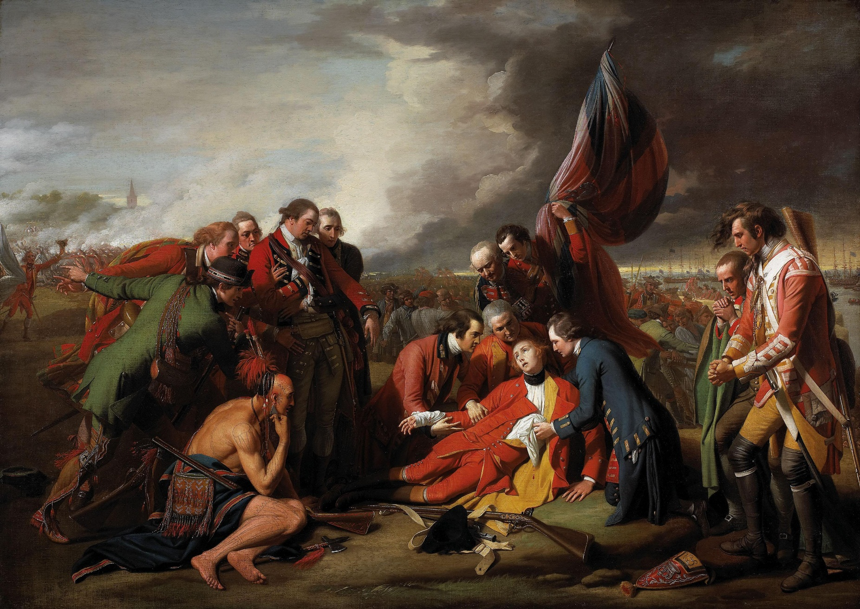
Death of General Wolf, 1770
Benjamin West
4’11”x7’ National Gallery of Art, Ottawa

Slide 3
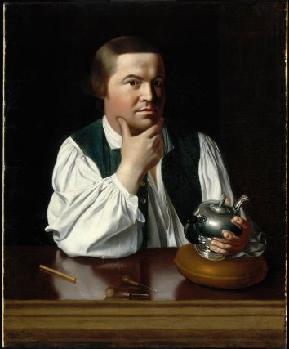
Paul Revere, 1768-1770
John Singleton Copley
35 1/8 x 28 1/2 in, Museum of Fine Arts, Boston
An idealized image of the artisan at work – casual clothing but a pristine “work” area.
The reason for the commission of this portrait and the identification of the client who paid for it remain mysteries.
“Paul Revere” did not become a public image during the Revolution or in its aftermath. The Copley portrait remained in the Revere family after the sitter’s death in 1818, apparently relegated to an attic because it was “too informal”.

Slide 4
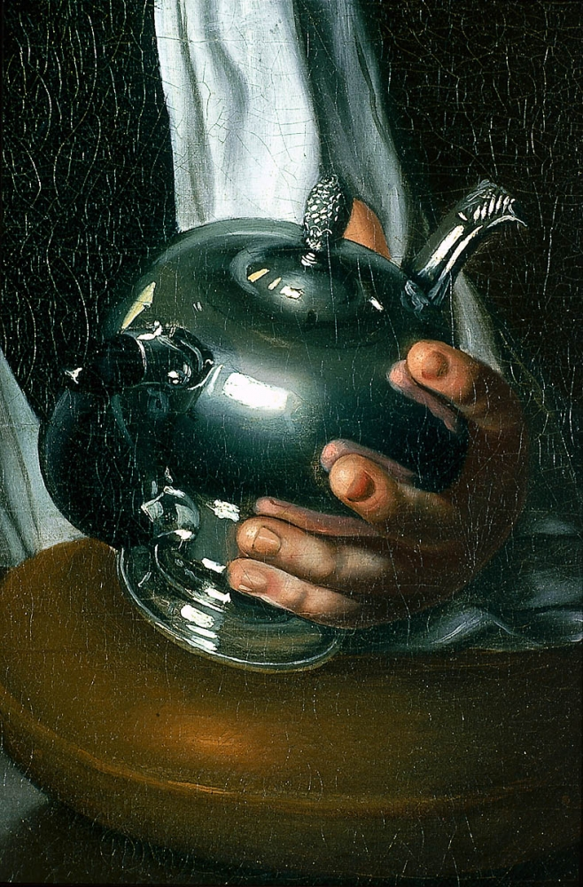
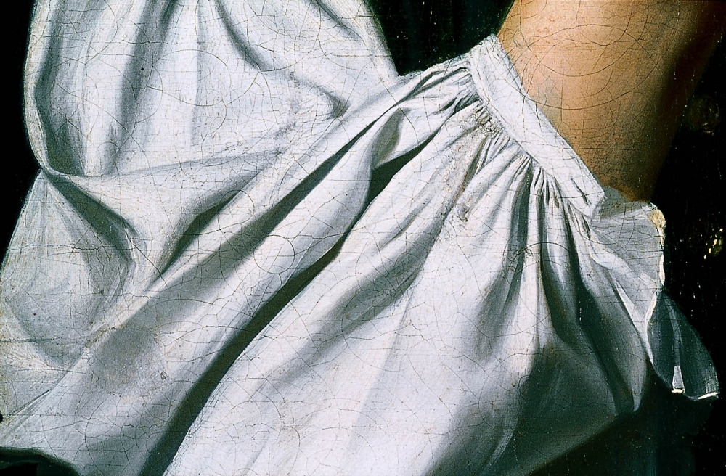

Slide 5
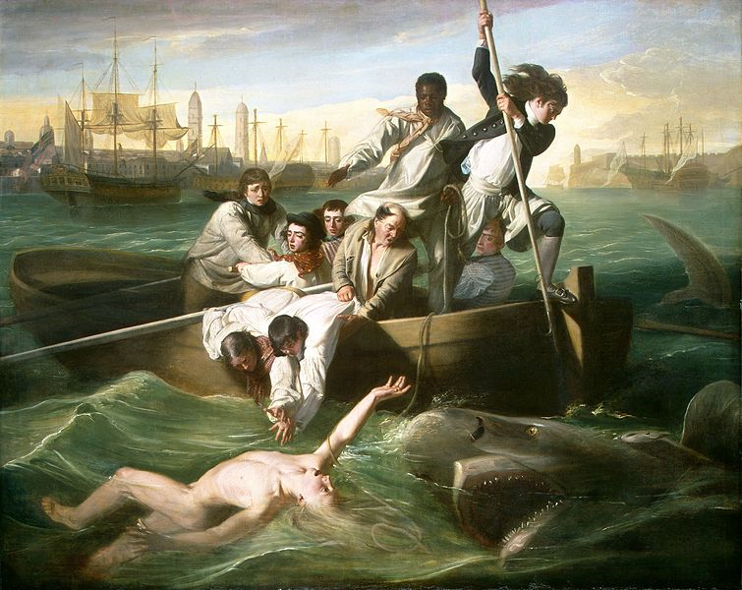

Slide 6
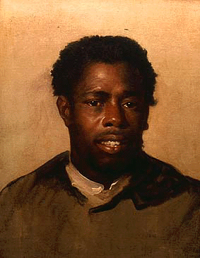
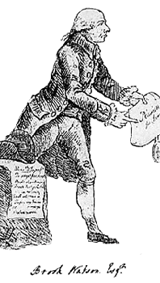
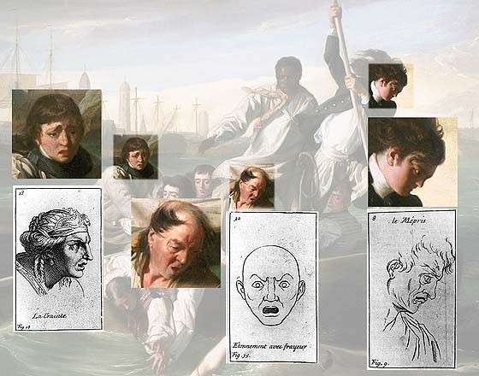
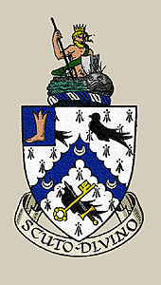
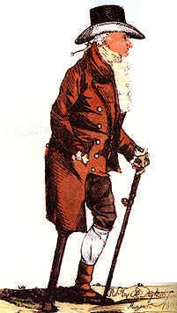
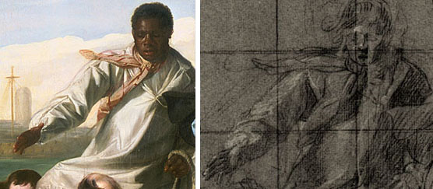

Slide 7
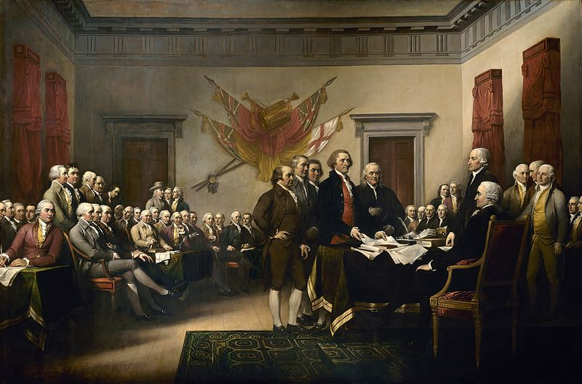
The Declaration of Independence, July 4, 1776 John Trumbull
1818 12’x18’ United States Capitol Building
The painting features the committee that drafted the Declaration of Independence— John Adams, Roger Sherman, Robert Livingston, Thomas Jefferson (presenting the document), and Benjamin Franklin — standing before John Hancock, the President of the Continental Congress.

Slide 8
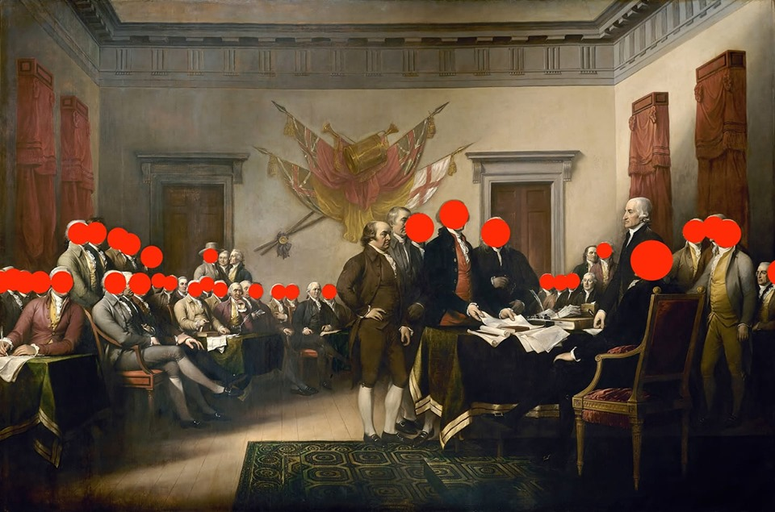

Slide 9
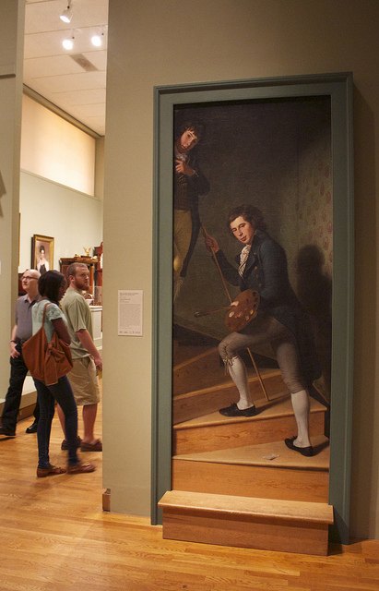
Staircase Group, 1795
7’5”x39”
Charles Willson Peale
Philadelphia Museum of Art
Example of “trompe l'oeil” painting

Slide 10
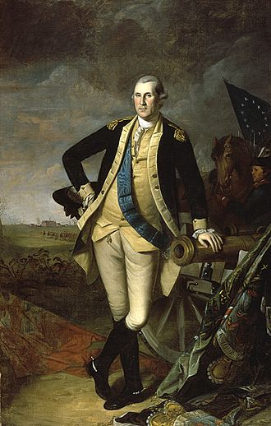
“Washington at Princeton”, 1779
Sold for 21.3 million dollars in 2005

Slide 11
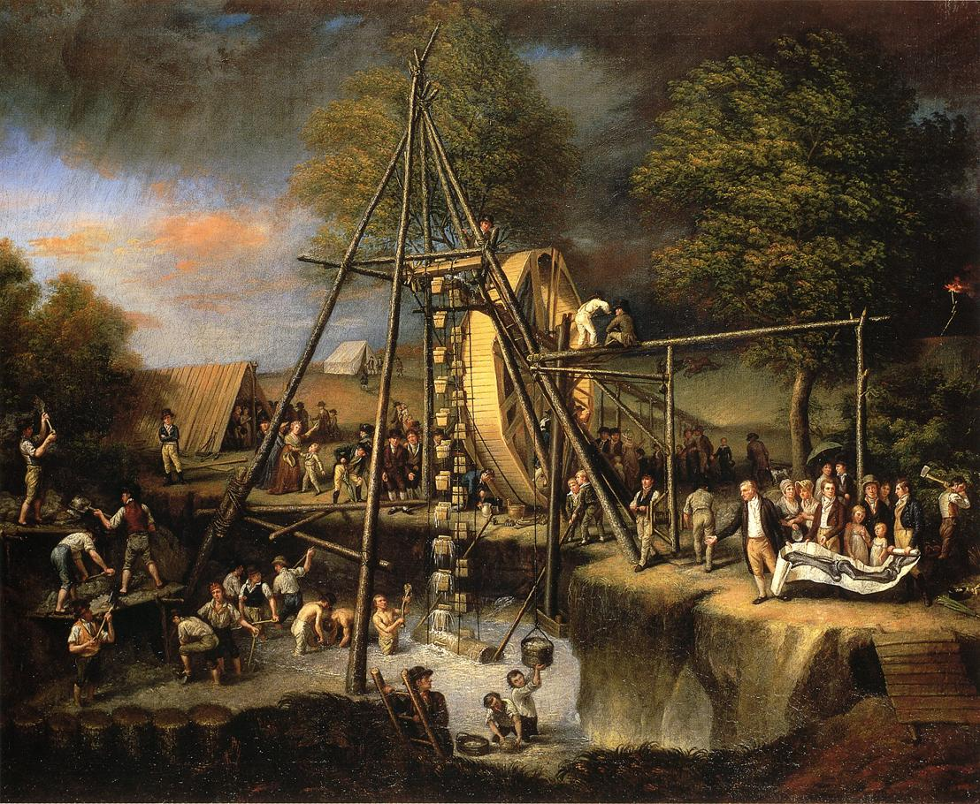
Exhumation of the Mastodon,
Charles Willson Peale 1806 49 x 61½”

Slide 12
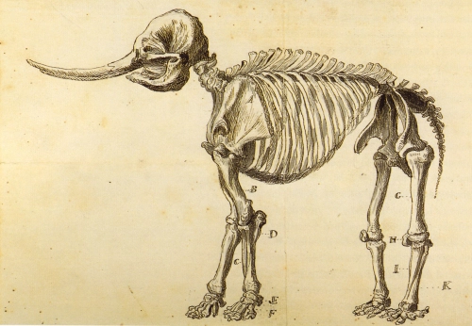
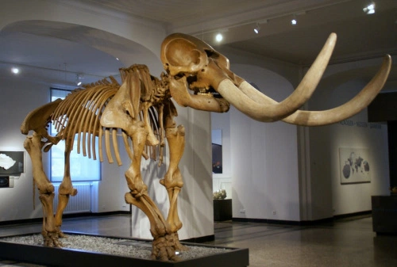

Slide 13
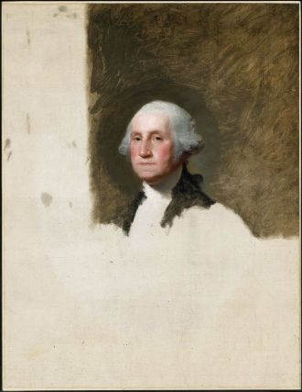
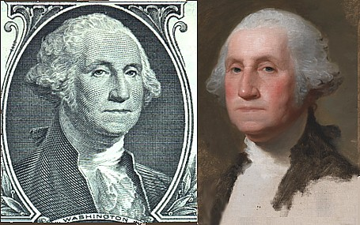
George Washington, 1796
Gilbert Stuart
National Portrait Gallery and Museum of Fine Arts, Boston
His best known work, the unfinished portrait of George Washington, sometimes referred to as The Athenaeum, was begun in 1796 and never finished.
Stuart kept the portrait and used it to paint 130 copies which he sold for $100 each.
The image of George Washington featured in the painting has appeared on the United States one-dollar bill for over a century, and on various U.S. Postage stamps of the 19th century and early 20th century.

Slide 14
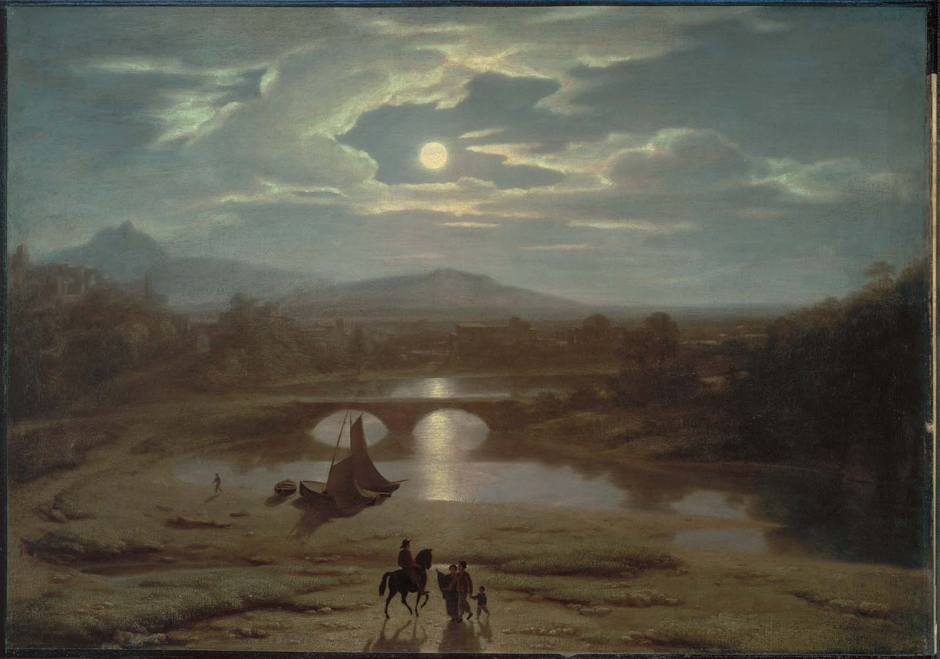
Moonlit
Washington Allston
1819 25 1/8 x 35 3/4 in Museum of Fine Arts, Boston

