Slide 1
Nixon to Reagan 1968-1984
A CONSERVATIVE REVOLUTION

Slide 2
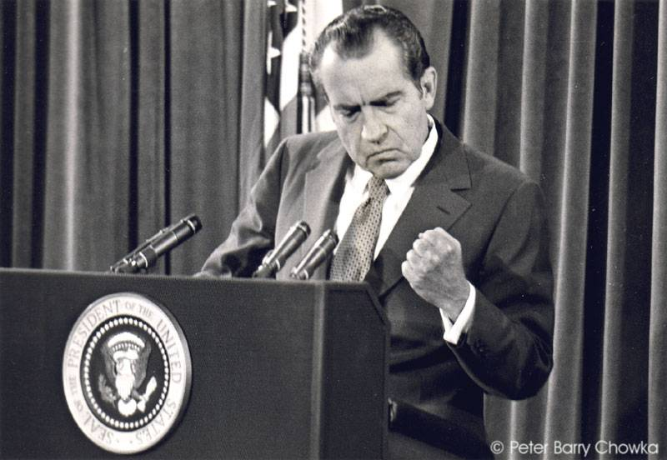
Nixon’s Domestic Policy: New Federalism
Reduce the role of the federal government
Great Society—too expensive
Solution:
Revenue sharing—fed. govt gives part of income to states; their choice as to what social welfare programs
Goals:
Reduce inflation
Reduce social programs
Strengthen law and order - discourage protests
Move slowly on civil rights

Slide 3
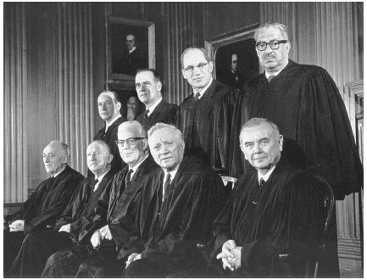
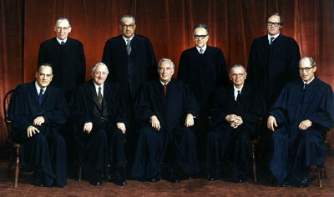
Tackling the Supreme Court
Nixon complained about the “permissiveness” and “judicial activism” of the Warren Court
Appointments: four conservatives out of nine members by 1971
1969-Warren Burger, the new Chief Justice
But once they have office they may or may not be conservative—their choice
Burger Court—reluctant to dismantle liberal Warren policies
Roe v. Wade (1973) legalized abortion in 1st trimester/constitutional right to privacy
Bakke v UC (1978) No race quotas, affirmative action could be used
Warren Court
Warren Court
Burger Court
Notes:
Warren Courts -50’s and 60’s (Earl Warren)—Expands Civil Rights, Civil Liberties and Power of Government

Slide 4
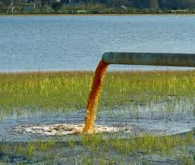
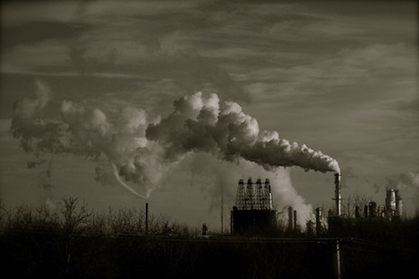
Nixon on the Environment
1970-Environmental Protection agency (EPA)
Occupational Health and Safety Administration (OSHA)
Clean Air Act
Clean Water Act
Endangered Species Act of 1973
Notes:
Clean Water---goals of how much toxin can be dumped
Endangered==establishes protection and lists of species

Slide 5
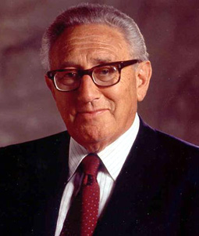
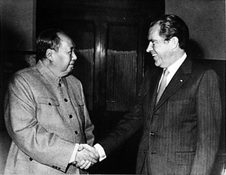
Foreign Policy: Détente
Role of Henry Kissinger: Nixon advisor and Secretary of State
Nixon Doctrine
Vietnamization
Nixon goes to China (1972)
Nixon goes to USSR (1972)
SALT I (Strategic Arms Limitation Talks)
SALT II
Henry Kissinger
Only Nixon could go to China
Notes:
Nixon Doctrine==" but would not "undertake all the defense of the free nations of the world.”—Urged peace
Vietnamization—withdrawal of troops from Vietnam and letting South gov take over
Nixon meets with Mao ZeDong---beginning of relations with China
Russia (1972) Nixon meets with Brezhnev---week long summit---leads to joint Space Flight and SALT 1(1974)
SALT 1 and SALT 2—reduction to 200 ballistic missiles each

Slide 6
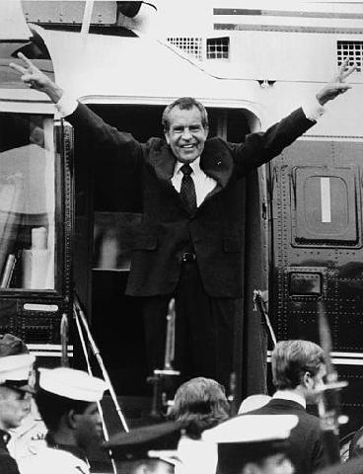
Watergate
June 1972, 2 months before re-nomination
Burglary in Democratic headquarters, Watergate office complex in WA
5 arrested
Republican Committee for the Re-election of the President (CREEP)
By 1974, 29 indicted, pled guilty or convicted
Improper use of FBI, CIA, and IRS
Secret tapes and missing 18 minutes

Slide 7
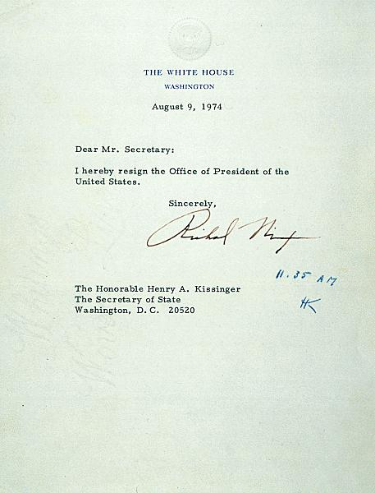
Nixon Resigns
House proposes three articles of impeachment
Obstruction of justice
Abuse of power
Contempt of Congress
Senate readies for trial
Nixon resigns from office: Vice president Gerald Ford sworn into office (1974)

Slide 8
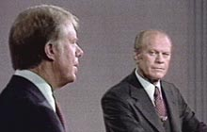
Ford-Carter Interlude
Rebuild the image of the presidency
Had initial problems
Nixon’s Pardon
Amnesty Plan
Offered amnesty to 1,000’s of draft dodgers
Stagflation
Inflation reached 12%, worst recession since WWII
Mortgage rates: 14%
Car loans: 21%
GNP: stagnate
Carter-Ford Debate-1976

Slide 9
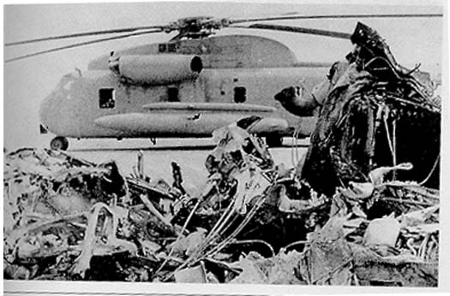
Ford-Carter Interlude
Henry Kissinger-helped negotiate a cease-fire agreement (Egypt & Israel)
End to 1973 Yom Kippur War & Oil Embargo
Continued Détente (grain to USSR)
Oversaw withdraw of last troops in Vietnam (1975)
Helsinki Accords (1975)
Hostage Crisis (1979)
American boycott of Moscow Olympics (1980)
Failed rescue attempt
Notes:
IRAN—1979-1981 (444 days) Islamic students hold people hostage at the US embassy in Tehran
Rescue attempt failed, got people killed----The Shah of Iran died, Iraq invaded Iran---Hostages released after Reagan gets into office
Knew Reagan would use larger amount of force

Slide 10
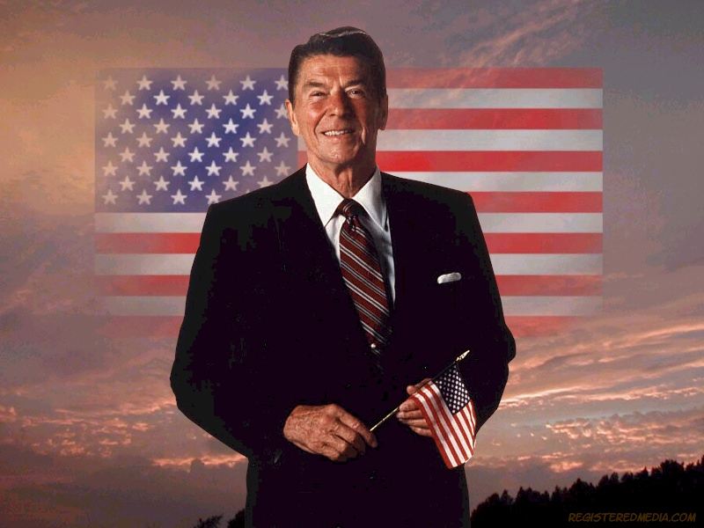
Election of 1980
Why did Reagan win?
1980 census—
population aging
more conservative move from liberal NE to “sunbelt” states” (south & west)
1970’s revival of evangelical religion: a great awakening
Age of Televangelists: Reverend Jerry Falwell’s “moral majority”—culture wars
Opposed liberal political candidates favored free enterprise, reduce size of government, abortion outlawed, prayer in school, evolution replaced by creationism, Soviets are pagan totalitarians, defend traditional values and tough on criminal laws.
Backlash against Feminist Movement
Bad economy
Reagan made Americans feel proud to be American again - believe in the greatness of the USA

Slide 11
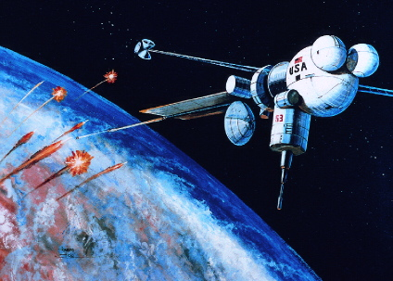
Morning in America
Reagan
Oldest President
Achieved fame as an actor
Former governor of California
Plan:
Restore faith and confidence in America
Resume the Cold War:
(“the evil empire”)
Reduce the deficit
Reduce the role & size of the Federal government
Star Wars

Slide 12
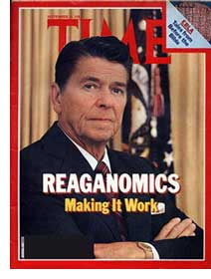
New Federalism - “Reaganomics”
Supply-side economics (or trickle down theory)
Reduce federal tax rates for wealthy & corporations
People (the wealthy) will spend more money
Companies will invest
In addition:
Reduce spending on social and educational programs
Opposed renewal of Voting Rights Act
Opposed ERA (Equal Rights Amendment)
Notes:
Voting Rights Act (1965) by LBJ and Great Society

Slide 13
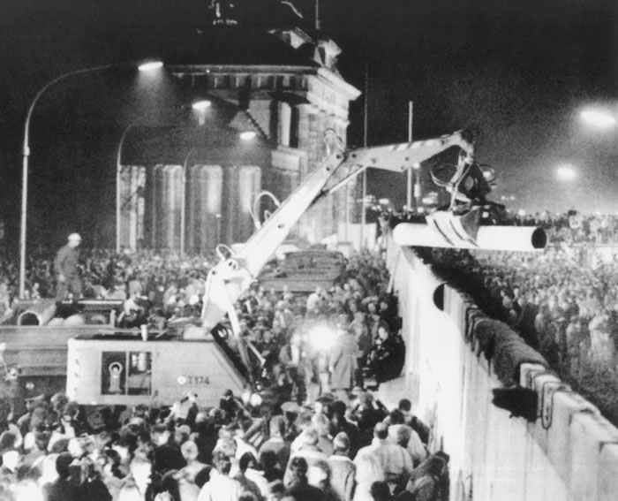
Resumption and End of Cold War
Create a 600 ship navy
Increase nuclear weapons (40,000 warheads)
Strategic Defense Initiative (SDI) or Star Wars
Aggressive Foreign policy
Grenada Invasion
Lebanon
Libya
Rise of Mikhail Gorbachev of USSR
(glasnost = openness & perestroika = restructuring )
Met four times to reduce nuclear weapons
End of Cold War 1989
Fall of Berlin Wall
Notes:
Glasnost-transparency, introduced by Gorbachev
Perestroika---restructuring of communist party within Russia with Glasnost

Slide 14
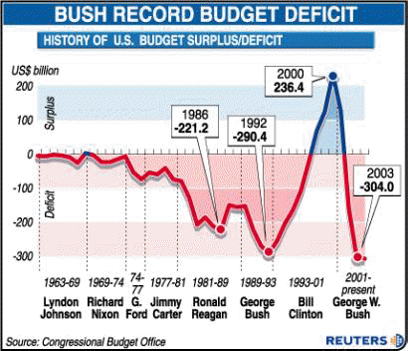
Consequences
Known as Teflon President
War on Drugs
Iran-Contra Affair
Rise of the Religious Right and intensity of the culture wars
End of the Cold War
Prosperity returns in mid 1980s
Notes:
IRAN CONTRA---sale of arms from U.S. to Iran—hopes of freeing hostages that were being held
U.S. ships arms to Israel then to Iran and U.S. receives payment from Israel

